Slide 1

Project on Mini Mart Website
.

Slide 2

Html, CSS and Java Script code on Mini Mart Website
HTML stands for Hyper Text Markup Language, which is the most widely used language on Web to develop web pages. HTML was created by Berners-Lee in late 1991 but "HTML 2.0" was the first standard HTML specification which was published in 1995. HTML 4.01 was a major version of HTML and it was published in late 1999. Though HTML 4.01 version is widely used but currently we are having HTML-5 version which is an extension to HTML 4.01, and this version was published in 2012.
HTML was developed with the intent of defining the structure of documents like headings, paragraphs, lists, and so forth to facilitate the sharing of scientific information between researchers. Now, HTML is being widely used to format web pages with the help of different tags available in HTML language.
HTML is a MUST for students and working professionals to become a great Software Engineer specially when they are working in Web Development Domain

Slide 3
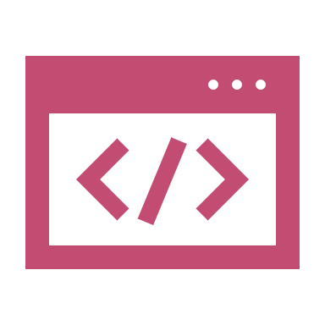
CSS
Cascading Style Sheets, fondly referred to as CSS, is a simple design language intended to simplify the process of making web pages presentable.
CSS is a MUST for students and working professionals to become a great Software Engineer specially when they are working in Web Development Domain
CSS is used to control the style of a web document in a simple and easy way.
CSS is the acronym for "Cascading Style Sheet". This tutorial covers both the versions CSS1,CSS2 and CSS3, and gives a complete understanding of CSS, starting from its basics to advanced concepts.

Slide 4
Java Script
JavaScript is a lightweight, interpreted programming language. It is designed for creating network-centric applications. It is complimentary to and integrated with Java. JavaScript is very easy to implement because it is integrated with HTML. It is open and cross-platform. Javascript is the most popular programming language in the world and that makes it a programmer’s great choice. Once you learnt Javascript, it helps you developing great front-end as well as back-end softwares using different Javascript based frameworks like jQuery, Node.JS etc.
Javascript is everywhere, it comes installed on every modern web browser and so to learn Javascript you really do not need any special environment setup. For example Chrome, Mozilla Firefox , Safari and every browser you know as of today, supports Javascript.
Javascript helps you create really beautiful and crazy fast websites. You can develop your website with a console like look and feel and give your users the best Graphical User Experience.
JavaScript usage has now extended to mobile app development, desktop app development, and game development. This opens many opportunities for you as Javascript Programmer.
Due to high demand, there is tons of job growth and high pay for those who know JavaScript. You can navigate over to different job sites to see what having JavaScript skills looks like in the job market.
Great thing about Javascript is that you will find tons of frameworks and Libraries already developed which can be used directly in your software development to reduce your time to market.

Slide 5
Html css and java script Code for minimart
<!DOCTYPE html>
<html>
<head>
<meta name="viewport" content="width=device-width, initial-scale=1">
<style>
body {font-family: Arial, Helvetica, sans-serif;}
input[type=text], input[type=password] {
width: 100%;
padding: 12px 20px;
margin: 8px 0;
display: inline-block;
border: 1px solid #ccc;
box-sizing: border-box;
}
button {
background-color: #e9967a;
color: white;
padding: 14px 20px;
margin: 8px 0;
border: none;
cursor: pointer;
}…………………………………………………
</html

Slide 6
Test Plan
A Test Plan is a detailed document that describes the test strategy, objectives, schedule, estimation, deliverables, and resources required to perform testing for a software product. Test Plan helps us determine the effort needed to validate the quality of the application under test. The test plan serves as a blueprint to conduct software testing activities as a defined process, which is minutely monitored and controlled by the test manager.
Creating a Test Plan involves the following steps:
Product Analysis.
Designing Test Strategy.
Defining Objectives.
Establish Test Criteria.
Planning Resource Allocation.
Planning Setup of Test Environment.
Determine test schedule and estimation.
Establish Test Deliverables.

Slide 7
Test Senarios and casses
The test case is a detailed document, which provides information about the testing strategy, testing process, preconditions, and expected output. The test scenarios are those derived from the use case and give the one-line information about what to test.
It is a detailed document of test cases that cover end to end functionality of a software application in liner statements. The test scenario is a high-level classification of testable requirements. Before performing the test scenario, the test engineer needs to consider the test cases for each scenario.

Slide 8
Selenium
Selenium provides basic and advanced concepts of Selenium. Our Selenium tutorial is designed for beginners and professionals.
Selenium is one of the most widely used open source Web UI (User Interface) automation testing suite.
Our Selenium includes all topics of Selenium such as Features, Selenium vs QTP, Selenium Tool Suits, Selenium IDE, Selenium IDE Locating Strategies, Selenium WebDriver, WebDriver Features, WebDriver vs RC, WebDriver Installation, etc.

Slide 9
About the selenium
Selenium is one of the most widely used open source Web UI (User Interface) automation testing suite.It was originally developed by Jason Huggins in 2004 as an internal tool at Thought Works. Selenium supports automation across different browsers, platforms and programming languages.
Selenium can be easily deployed on platforms such as Windows, Linux, Solaris and Macintosh. Moreover, it supports OS (Operating System) for mobile applications like iOS, windows mobile and android.
Selenium supports a variety of programming languages through the use of drivers specific to each language.Languages supported by Selenium include C#, Java, Perl, PHP, Python and Ruby.Currently, Selenium Web driver is most popular with Java and C#. Selenium test scripts can be coded in any of the supported programming languages and can be run directly in most modern web browsers. Browsers supported by Selenium include Internet Explorer, Mozilla Firefox, Google Chrome and Safari.

Slide 10
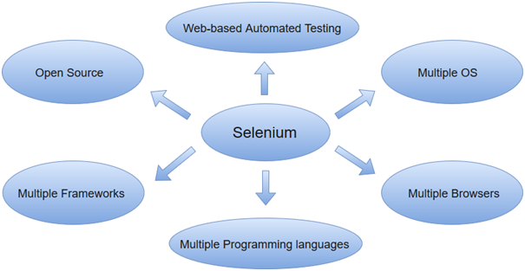
.

Slide 11
Using java to test the website using webdrivers in Eclipse IDE
Eclipse is the most popular Open Source Java IDE. More developers use Eclipse than any other tool for Java Programming. In this course, we take you on a fun ride with Eclipse.
Developed using Java, the Eclipse platform can be used to develop rich client applications, integrated development environments and other tools. Eclipse can be used as an IDE for any programming language for which a plug-in is available.

Slide 12
This is the java code I have written for testing the website
package BrowserCommands;
mport org.openqa.selenium.By;
import org.openqa.selenium.WebDriver;
import org.openqa.selenium.chrome.ChromeDriver;
public class BrowseCommands {public static void main(String[] args) {
// TODO Auto-generated method stub
System.setProperty("webdriver.chrome.driver","C:\\Users\\SushmithaGonnabathul\\OneDrive - ValueMomentum, Inc\\Documents\\chromedriver_win32\\chromedriver.exe");
WebDriver driver=new ChromeDriver();
driver.get("file:///C:/Users/SushmithaGonnabathul/OneDrive%20-%20ValueMomentum,%20Inc/Documents/Web%20application/Mini%20Project/website.html");
driver.manage().window().maximize();
driver.findElement(By.name("email")).sendKeys("Sushmitha.Gonnabathula@valuemomentum.com");
driver.findElement(By.id("psw")).sendKeys("Sushmitha");
driver.findElement(By.name("psw-repeat")).sendKeys("Sushmitha");
driver.findElement(By.xpath("/html/body/form[1]/div[1]/button/a")).click();
driver.switchTo().alert().accept();
driver.quit();
}
}

Slide 13

.
Thank you

